Slide 1


ME370
4-Legged Walker Final Report
Team 12:
Josh Stutzman, Marco Gasca, Brian Lee, Shubh Taneja
Section:
Date: 12/3/2021

Slide 2
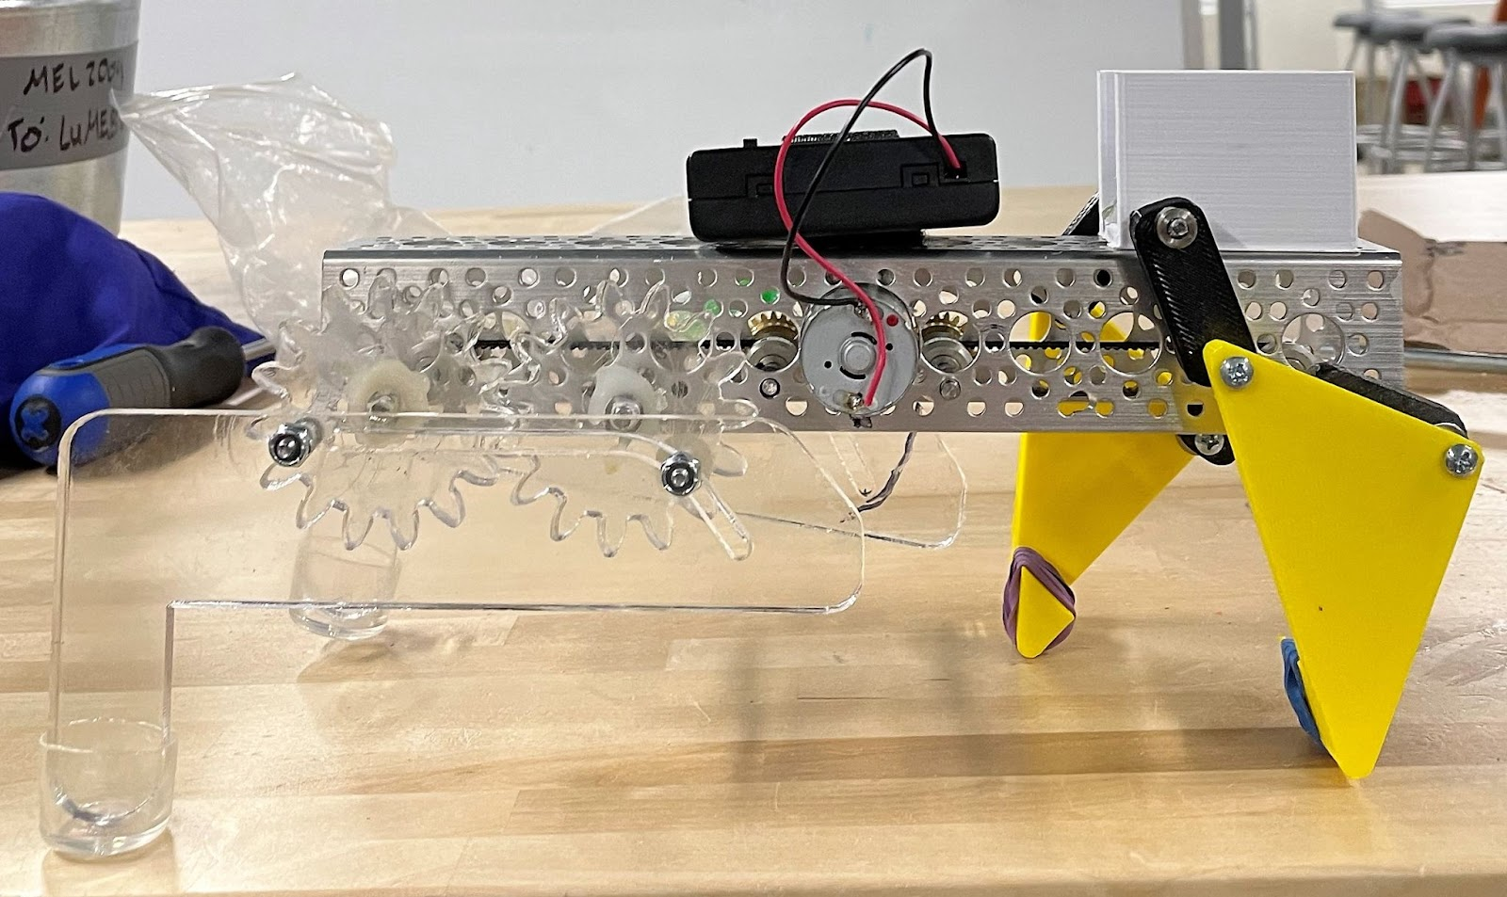
Overview
4 bar Linkage Design
Slot Cam Design
Power Source: 4 AA Batteries & DC Motor
2 Belts Transmit power
3 Gears in Total
( 30T Gear, 24T Gear )
Notes:
General Theme: legs closer to the u-base and have minimal parts to accomplish the goal.
Having many parts builds up movements creating unstable walker.

Slide 3
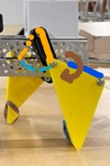
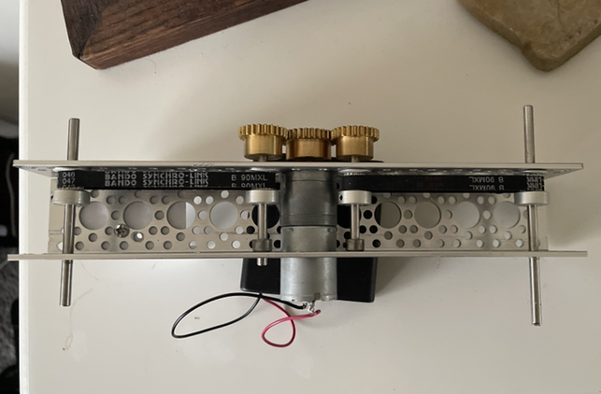
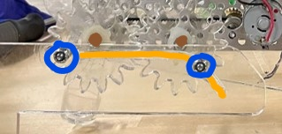
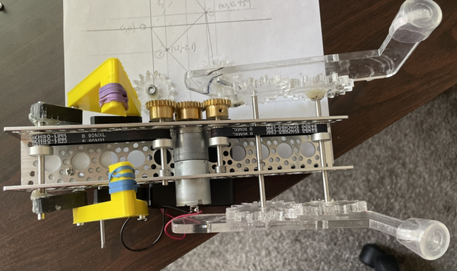
Power Transmission Unit
Side View
Bottom View 1
Rear Leg (Axial Translating Flat Form Closure)
Front Leg
Bottom View 2
Notes:
The transmission unit consists of one 30t gear, two 24t gears, two belts that transmit the rotational movement to the end of the u-base, and four shafts.
Rigid Link: provided the desired foot path, while keeping the legs closer to the u-base.
Cam-Follower: this type of design provided us to accomplish both vertical and horizontal motion of the leg at the same time.

Slide 4
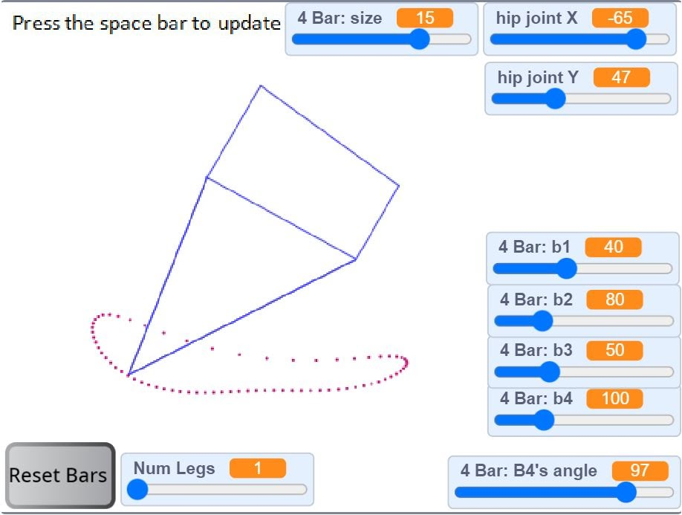
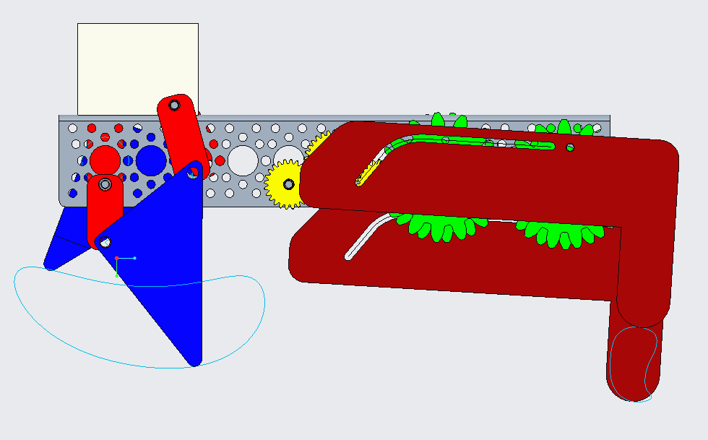
Foot Path
Notes:
Front leg has some flaws where it’s a quick return.
The pros for the rear leg is that it is not a quick return. It makes the step very stable and uniform.

Slide 5
Speed of the Walker
Load | 0g | 300g | 450g | 600g | 712.5g
RPM of DC Motor | 116.86 | 106.58 | 101.94 | 98.19 | 94.07
RPM 30T Gear |  |  |  |  | 94.07
RPM 24T Gear |  |  |  |  | 117.5828
Step Size : Approximately 8 cm/rotation
Calculated Speed : 13.7 cm/s
Approximately 90s to complete 12m
Notes:
From the DC motor lab, we calculated the approximated rpm for the motor, 30T gear, and 24t gear by applying the weight(712.5g) of the walker as the load.
Then calculated the actual speed of the walker. However, the actual speed of the walker differs quite significantly due to slipping and imbalance of the u-base creating the foot path to lose or make contact earlier than expected.

Slide 6
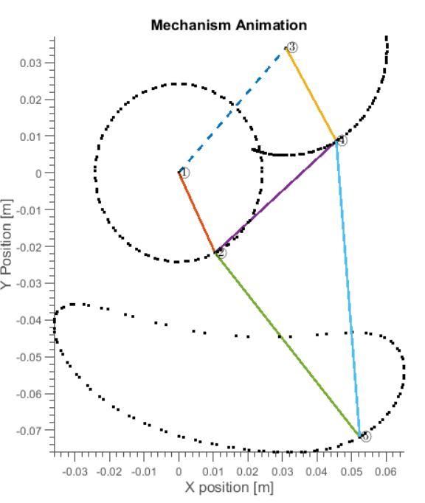
PVA and DFA Analysis of Rigid Linkage Leg Animation
Contact time- 60%
Stride Length L_{s} – 8cm
Lift Phase
Contact Phase

Slide 7
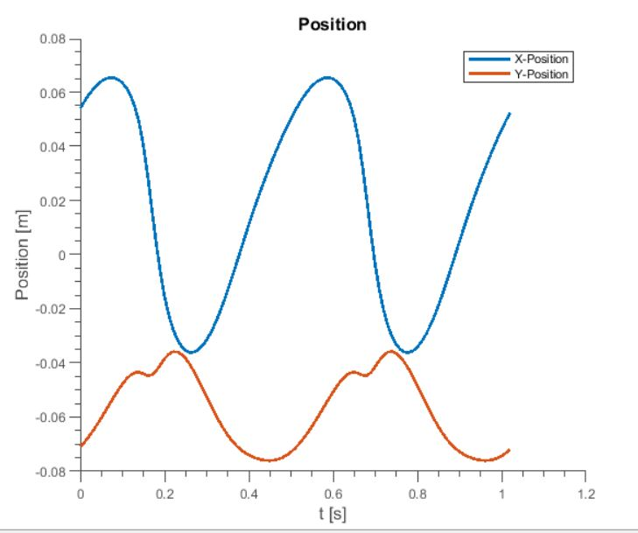
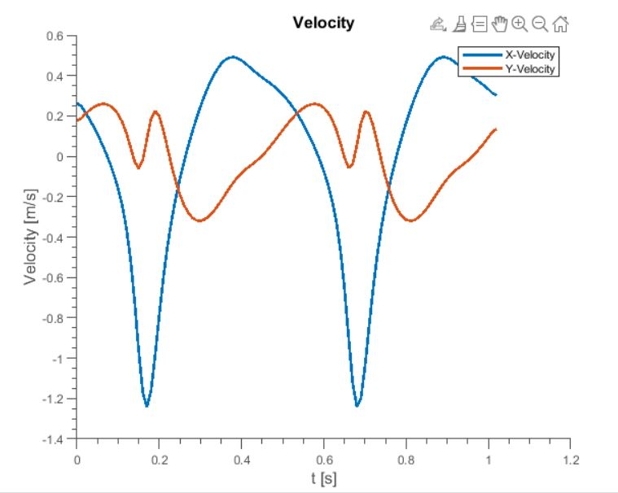
PVA and DFA Analysis of Rigid Linkage Leg
Contact Phase
Lift Phase

Slide 8
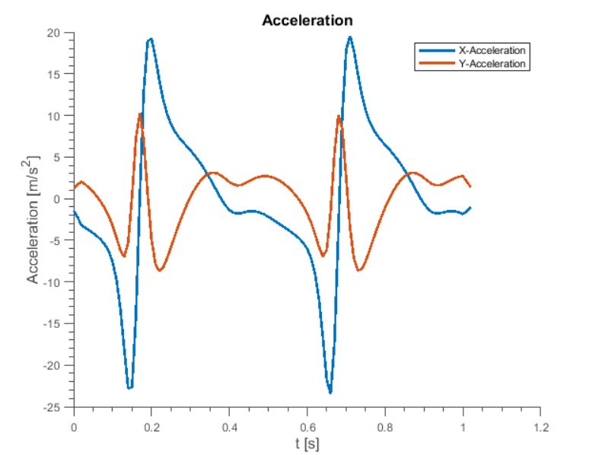
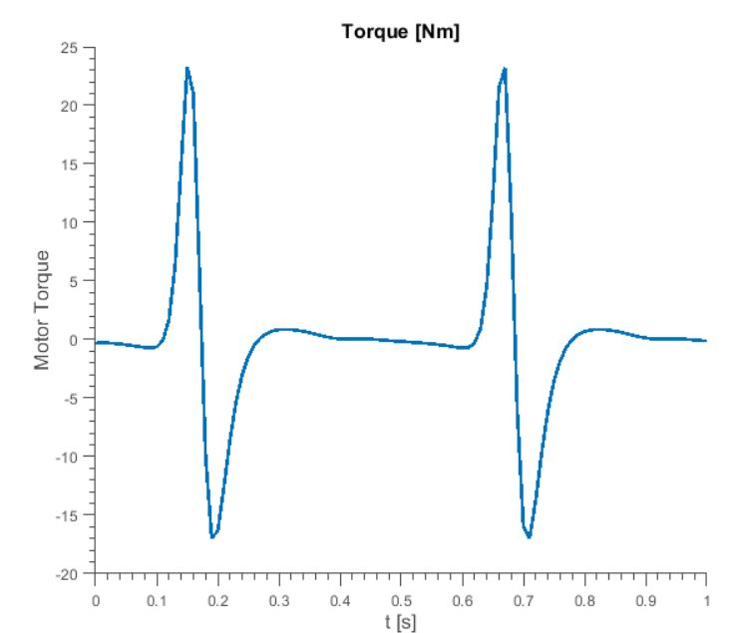
PVA and DFA Analysis of Rigid Linkage Leg
Contact Phase
Valid
Max Torque = -0.5Nm
Lift Phase
Invalid
Notes:
Acceleration was abnormally high for some unknown reason. The torque was very low except for the spikes which can be ignored.

Slide 9
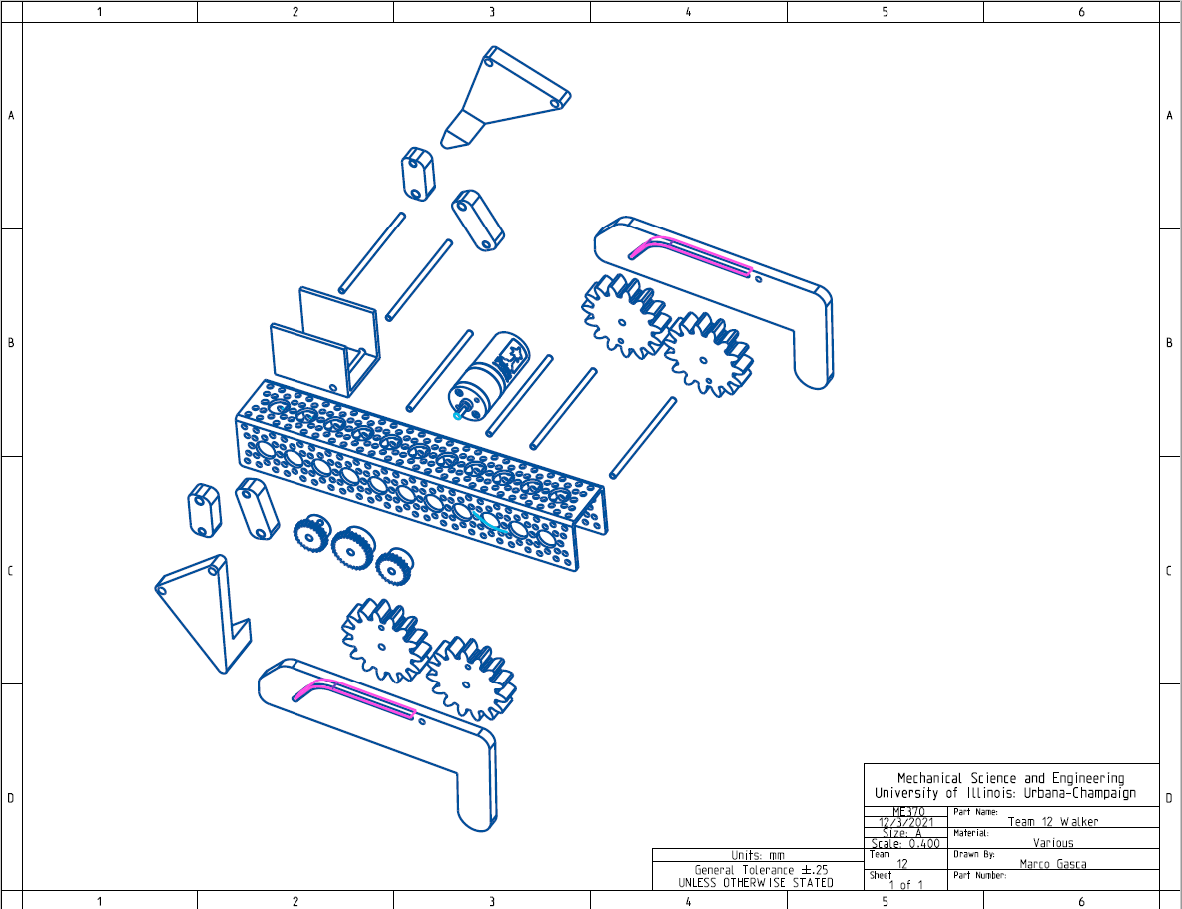
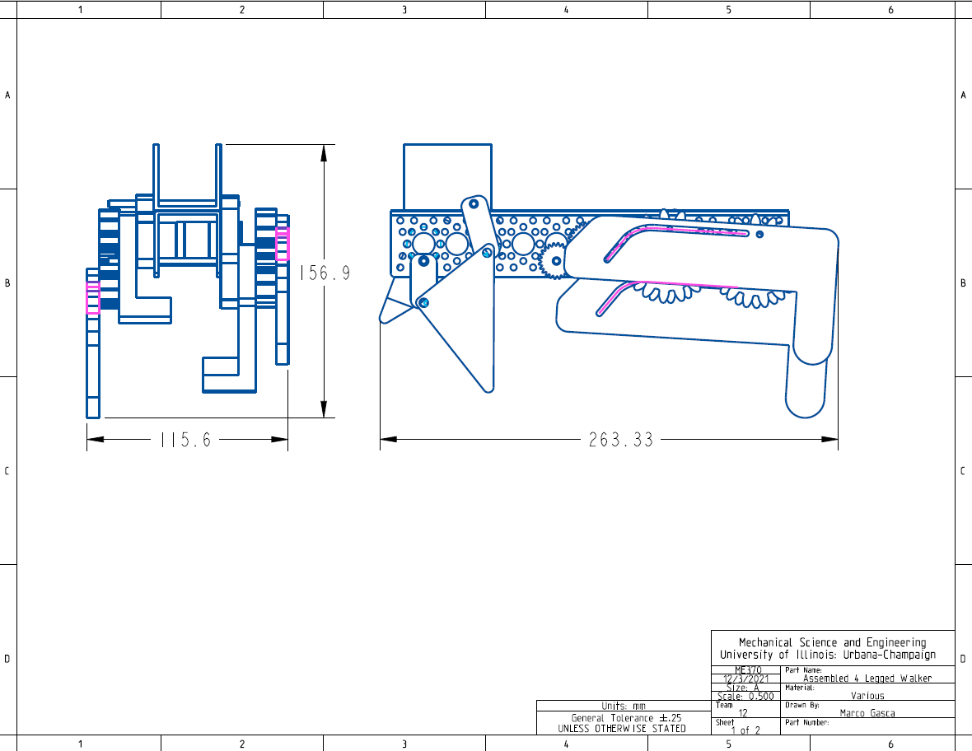
Exploded View and Engineering Drawings
Notes:
The transmission unit consists of one 30t gear, two 24t gears, two belts that transmit the rotational movement to the end of the u-base, and four shafts.

Slide 10
Budget and Bill of Materials
Cost Breakdown
Part | Quantity | Unit Cost ($) | Total Cost ($) | Part | Quantity | Unit Cost ($) | Total Cost ($)
U-base | 1 | 8 | 8 | Allen Wrench 1.27 mm | 1 | 0.2 | 0.2
DC Motor | 1 | 20 | 20 | Allen Wrench 1.5 mm | 1 | 0.2 | 0.2
24 Tooth Gear | 2 | 23.4 | 46.8 | Sleeve Bearing | 1 | 0.6 | 0.6
30 Tooth Gear | 1 | 25.2 | 25.2 | #6-32 Coarse Nut | 6 | 0.32 | 1.92
Batteries and Accessories | 1 | 22 | 22 | #6-32 ½” Machine Screw | 2 | 0.21 | 0.43
Belt Gear 15 Tooth | 4 | 14.6 | 58.4 | #6-32 ¾” Machine Screw | 4 | 0.21 | 0.85
182 mm Belt | 2 | 5.5 | 11 | Barrel Nut and Screw ⅞” | 4 | 0.5 | 2
Shaft Collar | 14 | 1.7 | 23.8 | Acrylic Sheet 24” x 12” x ¼” | 1 | 20 | 20
150 mm Shaft | 2 | 1.2 | 2.4 | ¼” x 36” steel rod | 1 | 3.4 | 3.4
50 mm Shaft | 2 | 1 | 2 | ⅞” Clear Leg Tip | 2 | 0.7 | 1.41
73 mm Shaft | 1 | 0.6 | 1.2 | 3D Printed Leg | 63g | 0.03 | 1.89
#10 Washers | 4 | 0.04 | 0.16 | 3D Printed U-base Extension | 17g | 0.03 | 0.51
Sum |  | 1 | 220.96 |  |  | 2 | 33.41
Total Cost |  |  |  |  |  | 1 + 2 | 254.37
Notes:
Most of the cost comes from the body of the walker- motor, gears, belts and batteries. The prototype legs themselves were very cheap and did not contribute much to the total cost. The total cost of the rocker is under budget, but enough of the budget was used to ensure that corners weren’t cut and a quality product was produced.

Slide 11
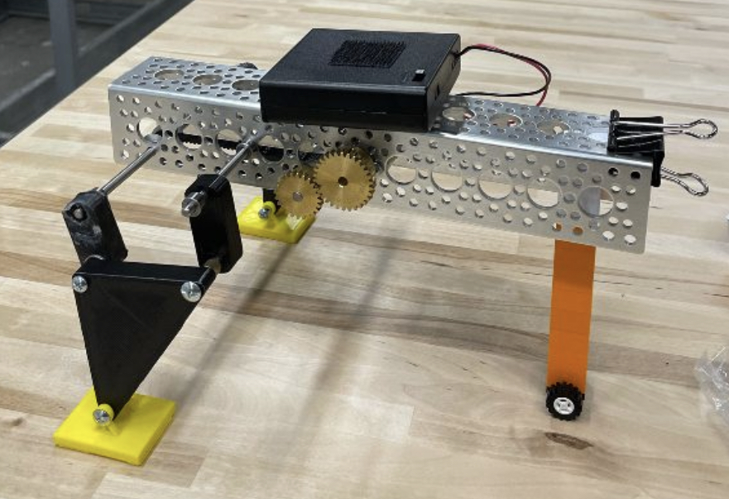
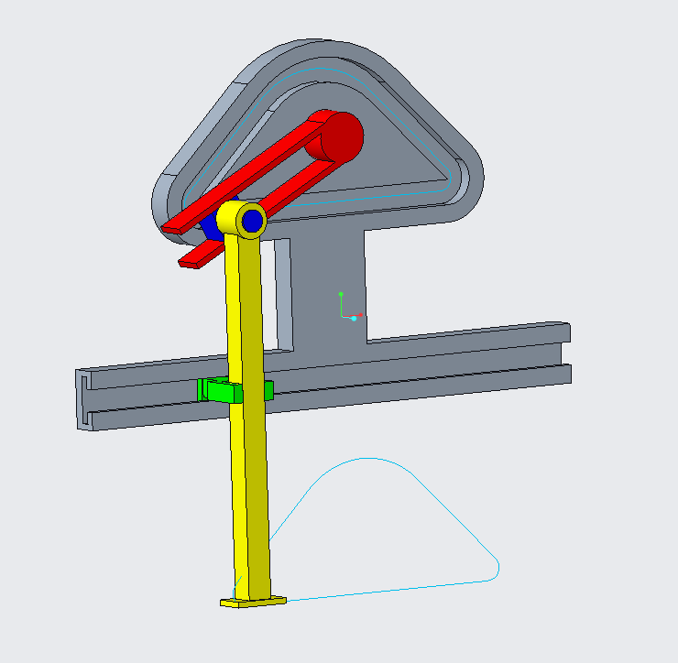
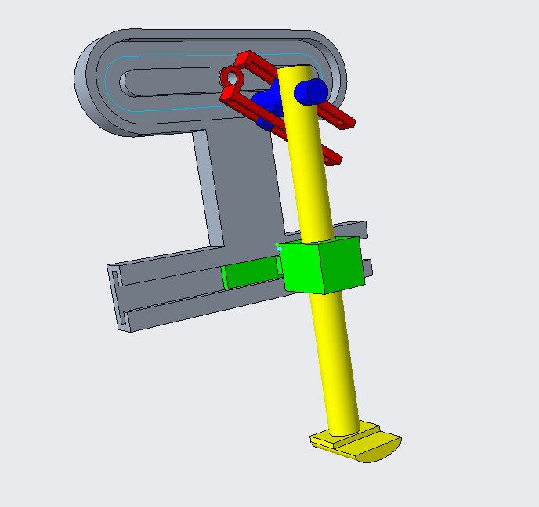
Design Failures / Lesson Learned
Linkage Design 1
Cam Design 1
Cam Design 2
Notes:
Design Iterations
Design1: The legs were too far out from the u-base. Single point contact for the rear wheel.
Cam Design 1:
Uncertainty over how the mechanism will behave at the sharp corners.
Nothing was holding the blue follower and the yellow leg to fall out of the slot.
The green clamp rotated as the blue follower lead the motion, making the mechanism to lock at one location
Cam Design 2:
Since the Red part is leading the motion, there was a delay in motion at the green slider. The delay created the yellow piece to be out of its perpendicular position to the ground.
Lesson Learned:
Designing: Considering fastening methods at the earlier stage
Manufacturing: Considering manufacturing challenges in 3d printing, long wait and tolerance issue
Testing: Considering the method of testing after manufacturing. Supply and the level of test we desire.
Right supply to keep one end for the u-base to maintain horizontal. The desired footpath was generated, but the foot was hitting the ground earlier than expected because the rear was lowered than the front.

Slide 12
Progression Video
https://drive.google.com/file/d/1e48WqrADJp_-YnRn2FuT256TExa1mEri/view?usp=sharing
Notes:
Just to be displayed on screen

Slide 13
Team Contributions
Design Review:
Marco Gasca: Measured possible hole to be utilized
Brian Lee: 3d modeling of the entire walker with the chosen design, Calculated the linkage
Josh Stutzman: Path generation for both legs
Shubh Taneja: Assisted in path generation
Milestone 1:
Marco Gasca: 3D printed the CAD parts
Brian Lee: Create CAD model of all the linkage parts and designed linkage
Josh Stutzman: Assembled the linkage design, and tested
Shubh Taneja: Brainstormed and suggested possible linkage designs
Milestone 2:
Marco Gasca: Create CAD model for the cam-follower design
Brian Lee: Assisted in creating cam-follower design, laser cut the parts, and tested the walker
Josh Stutzman: Assembled the cam-follower design, tested the walker, and assisted in design
Shubh Taneja: No contribution
Deliverables 2 & 3:
Marco Gasca: CAD rendering and assembly engineering drawings (Part 4)
Brian Lee: Design description and analysis (Part 1)
Josh Stutzman: PVA and DFA analysis and budget and BOM (Parts 2 & 3)
Shubh Taneja: 1-minute video
Notes:
Just to be displayed on screen

